Slide 1
Open vSwitch and Cloud
Portions of this PPT draw from PPT authored by Professor Dijiang Huang at
Arizona State University

Slide 2
Outline
Concept of SDN
OpenFlow – a SDN Implementation
Open vSwitch

Slide 3
Open vSwitch
Open vSwitch is a multilayer software switch that resides within the hypervisor and provides connectivity between the virtual machines and the physical interfaces.
It provides interfaces for manipulating the forwarding state and managing configuration state at run-time.
The 3 interfaces are :
Configuration interface
Forwarding path interface
connectivity management interface.

Slide 4
Open vSwitch
Configuration interface:
A remote process can read and write configuration state (as key/value pairs), and set up triggers to receive asynchronous events about configuration state changes.
Bond interfaces for improved performance and availability.
Provides bindings between network ports and the larger virtual environment.

Slide 5
Open vSwitch
Forwarding path interface:
Allows an external process to write the forwarding table directly.
The lookup can decide to forward the packet out of one or more ports, to drop the packet, or to en/decapsulate the packet.
Implements a superset of the OpenFlow protocol.

Slide 6
Open vSwitch
Management interface:
Virtualization layer can manipulate its topological configuration. Ex: Creating switches.
Managing VIF and PIF connectivity
In its simplest deployment Open vSwitch is a traditional physical switch within the virtualization layer.
Enables distribution of the switch functions across multiple servers decoupling the logical network topology from the physical one.

Slide 7
Open vSwitch
Centralized Management
Virtual Private Networks
Mobility between IP subnets

Slide 8
Open vSwitch
Centralized Management
The interfaces provided by Open vSwitch can be used to create a single logical switch image across multiple Open vSwitches running on separate physical servers.
Therefore, as VMs join, leave, and migrate, it is the responsibility of this management process to ensure any configuration state remains coupled to the logical entities.
It is possible to query and configure a collection of virtual switches as if they were a single switch.

Slide 9
Open vSwitch
Virtual Private Networks
Collection of VMs can be connected to each other over a private, virtual network implemented on top of a shared physical network infrastructure.
VMs sharing a private network spread across multiple hosts/physical switches, requires virtualization networking layer to support dynamic overlay creation.
Open vSwitch uses tunnels (GRE) to encapsulate an Ethernet frame inside an IP datagram to be routed.

Slide 10
Open vSwitch
Virtual Private Networks
A global management process can select the best way to forward packets from one VM to another modifying flow tables accordingly in Open vSwitches:
Virtual private network on the same Open vSwitch
VLANs (same subnet)
GRE tunnels (multiple subnets)

Slide 11
Open vSwitch
Mobility between IP subnets
Well known limitation of virtualization platform is that migration must happen within an IP subnet.
But, migration between subnets is desirable as single L2 domains have scalability limits.
A model similar to Mobile IP can be used, where a base Open vSwitch can receive all packets for a VM and forwarding the packet to its true location using tunneling.

Slide 12
Open vSwitch
Open vSwitch implementation consists of two components:
kernel-resident “fast path”
userspace “slow path”

Slide 13
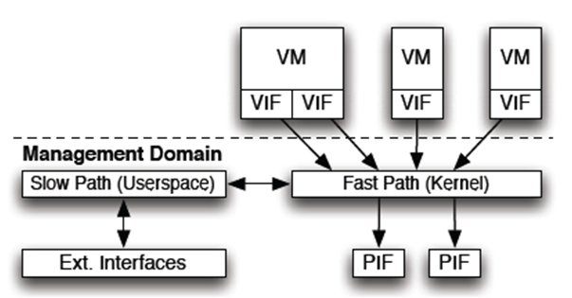
Open vSwitch
IMPLEMENTATION

Slide 14
Open vSwitch
IMPLEMENTATION
Fast path implements forwarding engine which is responsible for per-packet lookup, modification and forwarding.
Majority of functions is implemented within slow path running in the VM management domain (Dom0).
Implements forwarding logic
MAC learning
Load balancing
Remote visibility – OpenFlow, NetFlow etc.

Slide 15
Open vSwitch
IMPLEMENTATION
Fast path, being speed critical portion of the system has 3000 lines of code within the kernel and is system-specific.
Open vSwitch emulates Linux bridging code and can be used as a replacement for virtual switches used by XenServer.

Slide 16
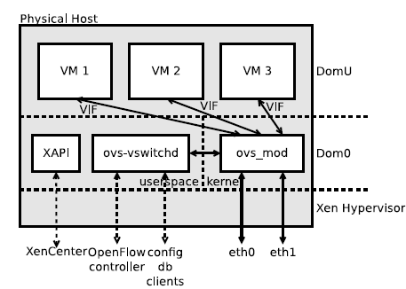
Open vSwitch
Open vSwitch integration with XenServer

Slide 17
Open vSwitch
Open vSwitch integration with XenServer
Open vSwitch works seamlessly with XenServer, will ship with Open vSwitch as the default.
XAPI is responsible for managing all aspects of a XenServer.
Notifies Open vSwitch of events related to network configuration.
Notifies Open vSwitch when bridges should be created and interfaces should be attached to them.
Open vSwitch stores this information in its configuration database, which notifies any remote listeners, such as a central controller.

Slide 18
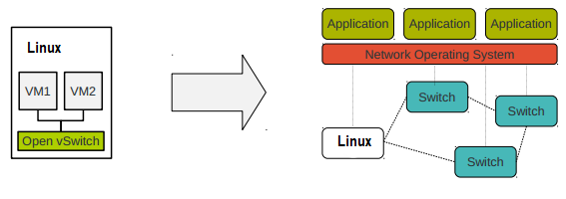
Why Open vSwitch
Open vSwitch enables Linux to become part of a SDN architecture.

Slide 19
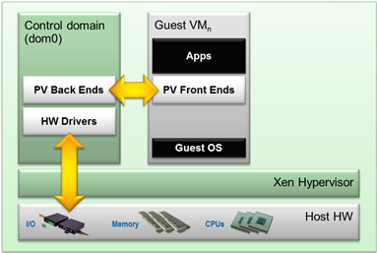
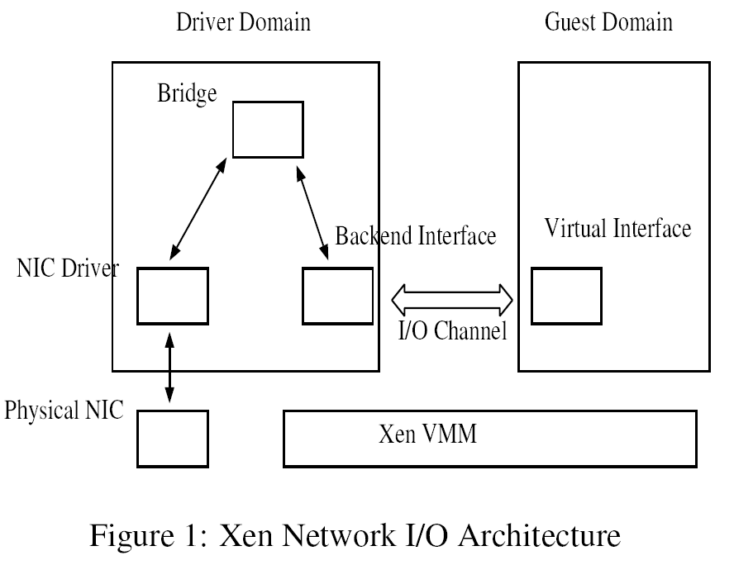
Software Switch Networking I/O Architecture
Domain 0/
Driver Domain/
Privileged Domain
Domain U/
Guest Domain/
Unprivileged Domain
Domain 0
Domain U
D0
DU
DU
DU
Hypervisor
Hardware
Hypervisor
XEN Para-virtualization (PV) Architecture
Notes:
Paravirtualization (PV) is an efficient and lightweight virtualization technique introduced by Xen, later adopted by other virtualization solutions. PV does not require virtualization extensions from the host CPU and thus enables virtualization on hardware architectures that do not support Hardware-assisted virtualization. However, PV guests and control domains require kernel support and drivers that in the past required special kernel builds, but are now part of the Linux kernel as well as other operating systems.
This figure shows the network architecture used in Xen.
Xen provides each guest domain with a virtual network interfaces(, which is used by guest domains for its network communications).
Each virtual interface in a guest domain has a backend interface in the driver domain.
The virtual and backend interfaces are connected over an I/O channel.
The I/O channel implements a zero-copy data transfer mechanism by remapping the physical pages.
This table shows the network performance under Xen.
The driver domain configuration shows performance comparable to native Linux for the transmit case and a degradation of 30% for the receive case.
But, in the guest domain, which uses virtualized network interfaces, the degradations are much more.
This performance degradation comes from a significantly higher TLB miss rate and a higher L2 cache miss rate.

Slide 20
Xen & Virtual Software Networking
The old version of Citrix XenServer (before v5.6 FP1) using simple Linux Bridge.
Many hypervisor based virtualization also apply Linux Bridge model, such as KVM, libvirt.
All of bridging work are done by ‘brctl’.
Provide simple L2 switching functions.
Virtual SW

Slide 21
Linux Bridge
The Linux bridge code implements a subset of the ANSI/IEEE 802.1d standard.
The original Linux bridging was first done in Linux 2.2. The code for bridging has been integrated into 2.4 and 2.6 kernel series.
Bridging functions are handled by bridge.ko kernel module and managed by user space management tool brctl command.

Slide 22
Open vSwitch’s Features
Visibility:
NetFlow, sFlow, Mirroring (SPAN/RSPAN/ERSPAN)
Control:
Centralized control through OpenFlow
Missed flows go to central controller
Fine-grained ACL and QoS (Quality of Service) policies
L2-L4 matching and actions to forward, drop, modify, and queue
Forwarding:
LACP (Link Aggregate Control Protocol)
Port bonding
Standard 802.1Q VLAN model with trunk and access ports
GRE, GRE over IPSEC, Ethernet-over-GRE and CAPWAP tunneling
Compatibility layer for Linux bridging code
High-performance forwarding using a Linux kernel module
Notes:
SPAN: Switched Port Analyzer
RSPAN: Remote Switched Port Analyzer
ERSPAN: Encrypted Remote Switched Port Analyzer

Slide 23
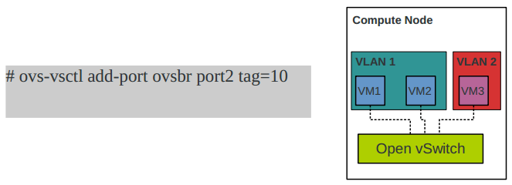
Feature – security/L2 segregation
VLAN isolation enforces VLAN membership of a VM without the knowledge of the guest itself.
port2
port4
port3
Any limit for VLAN ID?
Notes:
2^12 = 4096

Slide 24
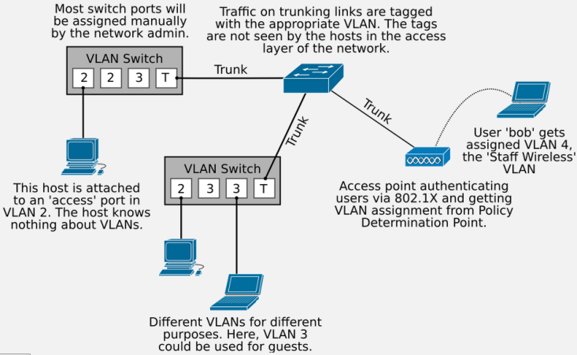
What is VLAN?
A Virtual LAN (VLAN) is the ability to segregate a switch into separate broadcast-domains.
Native VLAN ID or
PVID (Port VLAN ID)
Notes:
Clients, which are at the access layer of the network, will not have any idea that VLANs are in use, which is what we want, because it means the client doesn’t have any extra configuration to deal with. Thus, in this case, we say the switch-port is an “access” port, rather than a “trunk” port. In this case, the access layer device (typically a switch or wireless access point) will determine the VLAN based on the switch-port (typical for ethernet) or authentication data (typical for enterprise wireless access using 802.1X and RADIUS.

Slide 25
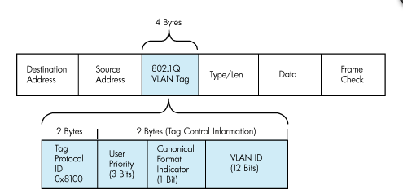
IEEE 802.1Q
The standard defines a system of VLAN tagging for Ethernet Frames.
VLAN ID limit: 2^12

Slide 26
Benefit of VLANs
VLANs give us three major benefits:
traffic control by prioritizing traffic in particular VLANs or reducing broadcast traffic by making the broadcast domains smaller
security, by controlling traffic between different VLANs (subnets),and
flexibility in network design without extra equipment.
What is difference between Subnet and VLAN?

Slide 27
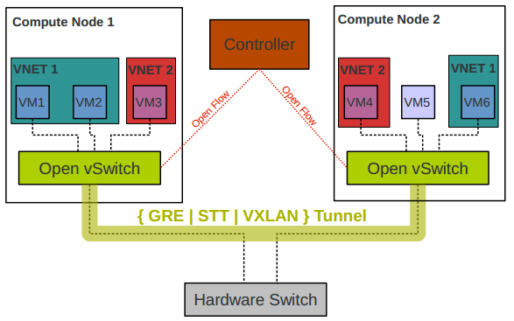
Feature – Tunneling
Tunneling provides isolation and reduces dependencies on the physical network.
Notes:
STT: stateless transport tunneling protocol.
GRE: Generic Routing Encapsulation
VXLAN: Virtual Extensible LAN

Slide 28
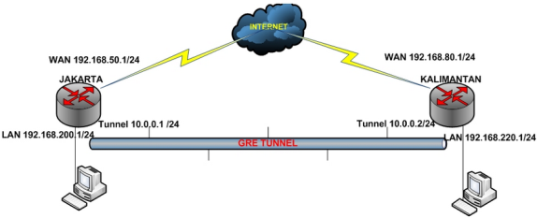
What is GRE Tunnel?
A Tunneling protocol that was developed by Cisco.
Generic routing encapsulation (GRE) can encapsulate a variety of protocol packet types inside IP tunnels.
This creates a virtual point-to-point link to Cisco routers at remote points over an IP network.
GRE tunneling is a layer 3 technology and as such requires a layer 3 device such as a router or layer 3 capable switch.
IP Hdr
GRE
IP Hdr
IP Payload
GRE Encapsulation

Slide 29
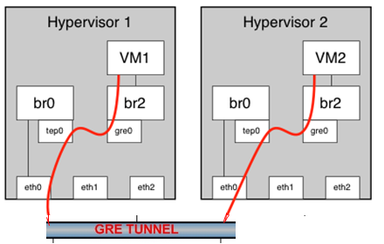
Create GRE Tunnel with OVS
# Create an Isolated Bridge
> ovs-vsctl add-br br2
# Create the GRE Tunnel Endpoint
> ovs-vsctl add-port br0 tep0 \
-- set interface tep0 type=internal
# Assign it with an IP address
> ifconfig tep0 192.168.100.10/24
# Establishing the GRE Tunnel
> ovs-vsctl add-port br2 gre0 \
-- set interface gre0 type=gre \
Options:remote_ip=192.168.200.10/24
# Repeat these commands on the other hypervisor
10.10.10.1
10.10.10.2

Slide 30
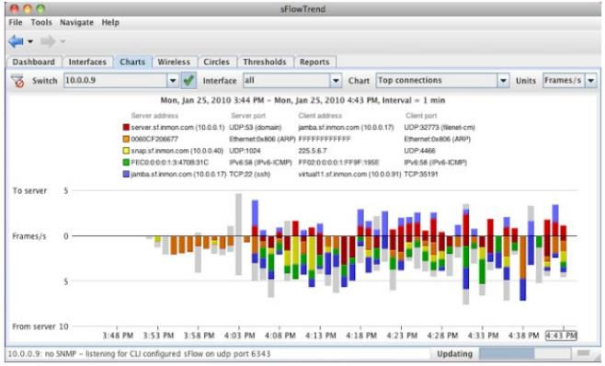
Feature – Visibility
Support industry standard technology to monitor the use of a network.
sFlow
NetFlow
Port Mirroring
SPAN
RSPAN
ERSPAN
Notes:
SPAN: Switched Port Analyzer
RSPAN: Remote Switched Port Analyzer
ERSPAN: Encrypted Remote Switched Port Analyzer

Slide 31
What is sFlow/NetFlow?
sFlow is a technology for monitoring network, wireless and host devices.
Flow samples: based on a defined sampling rate, an average of 1 out of n packets/operations is randomly sampled. This type of sampling does not provide a 100% accurate result, but it does provide a result with quantifiable accuracy.
Counter samples: A polling interval defines how often the network device sends interface counters.
sFlow datagrams: The sampled data is sent as a UDP packet to the specified host and port (6343).

Slide 32
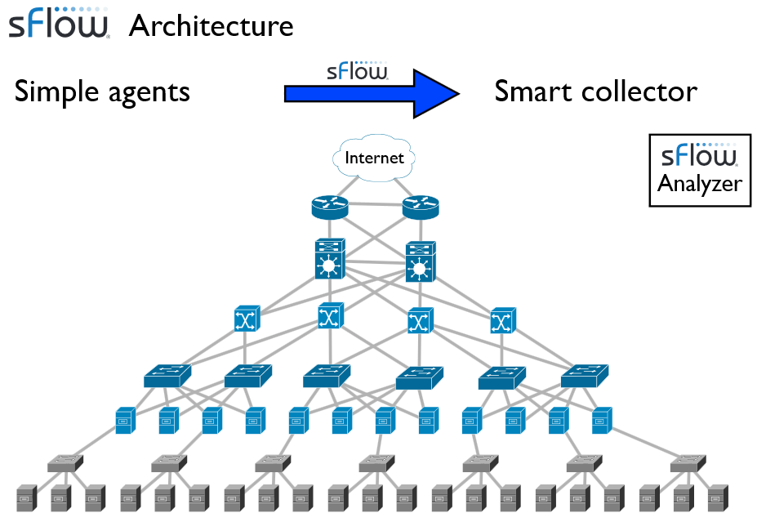
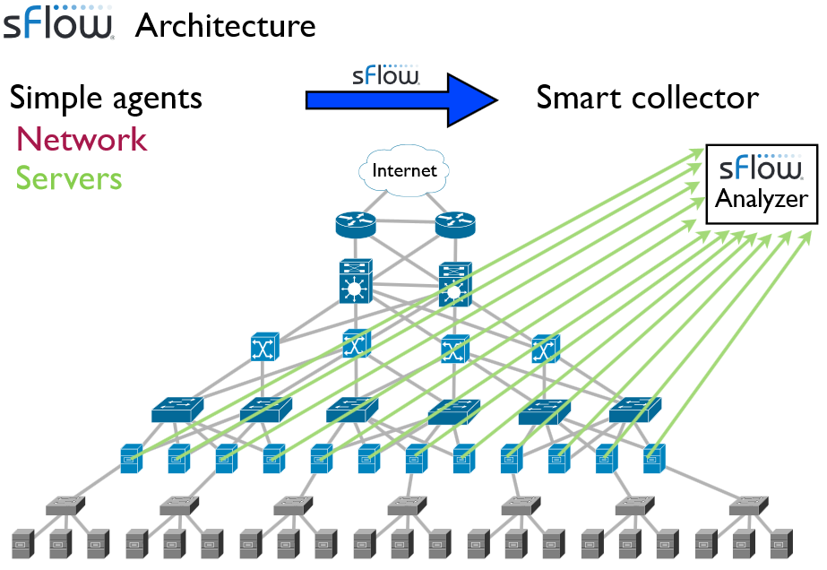
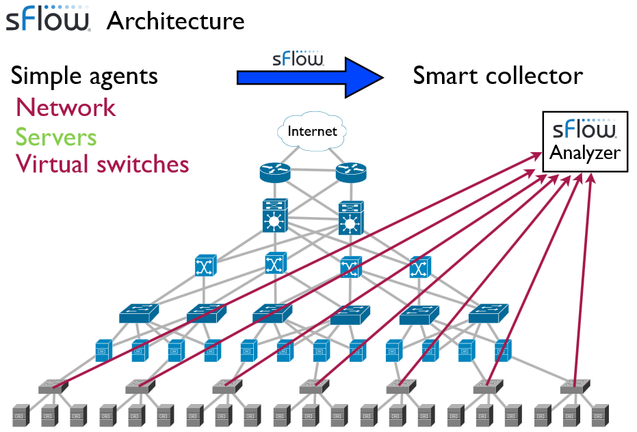
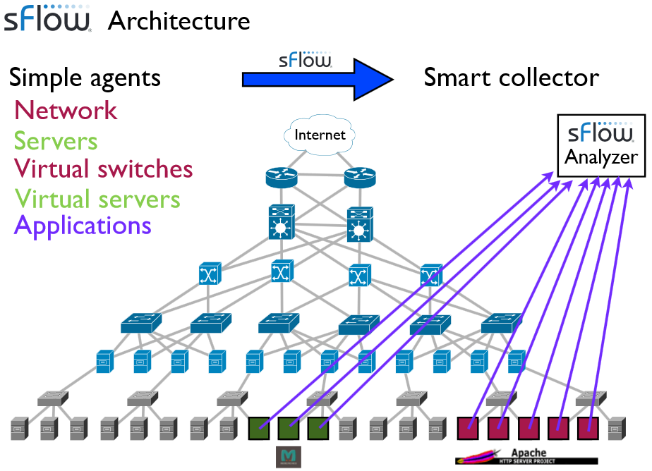
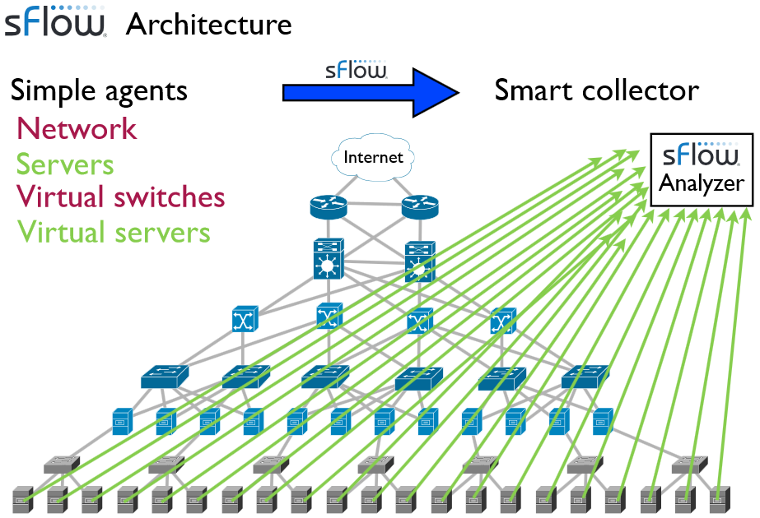
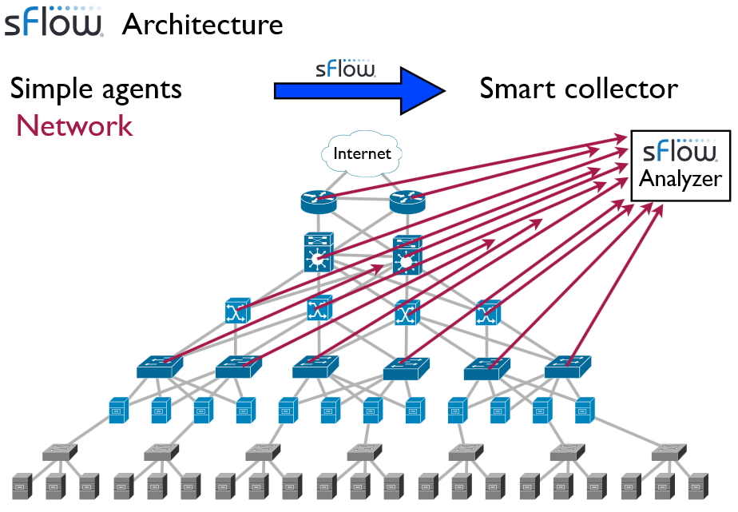

Slide 33
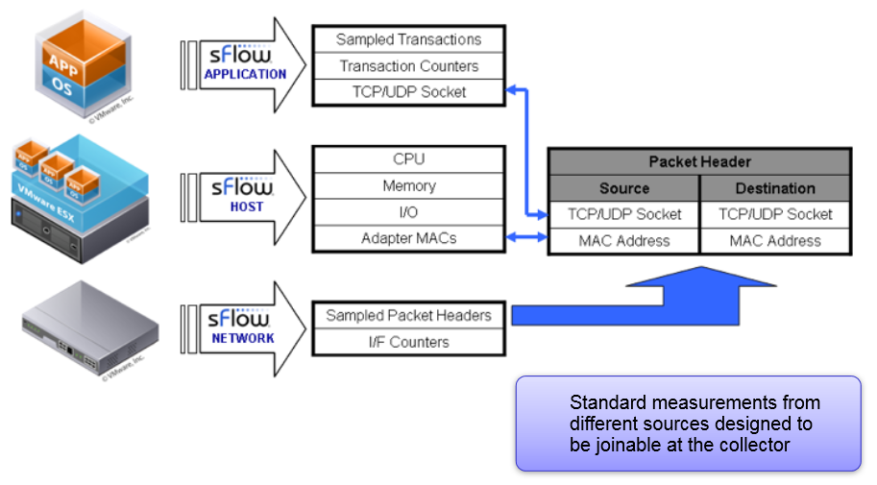
Cross-layer correlation: Application, Host and Network

Slide 34
Forwarding Components
Forwarding Components
ovs-vswitchd (control plane, slow path)
A daemon that implements the switch, along with a companion Linux kernel module for flow-based switching.
Forwarding logic (learning, mirroring, VLANs, and bonding)
Remote configuration and visibility
openvswitch_mod.ko (data plane, fast path)
Packet lookup, modification, and forwarding
Tunnel encapsulation/decapsulation

Slide 35
Other Modules and Tools
ovsdb-server: a lightweight database server that ovs-vswitchd queries to obtain its configuration.
ovs-brcompatd: a daemon that allows ovs-vswitchd to act as a drop-in replacement for the Linux bridge in many environments, along with a companion Linux kernel module to intercept bridge ioctls.
ovs-dpctl: a tool for configuring the switch kernel module.
ovs-vsctl: a utility for querying and updating the configuration of ovs-vswitchd.

Slide 36
Other Modules and Tools
ovs-appctl: a utility that sends commands to running Open vSwitch daemons.
ovs-ofctl: a utility for querying and controlling OpenFlow switches and controllers.
Ovsdbmonitor: a GUI tool for remotely viewing OVS databases and OpenFlow flow tables.
ovs-controller: a simple OpenFlow controller.
ovs-pki: a utility for creating and managing the public-key infrastructure for OpenFlow switches.

Slide 37
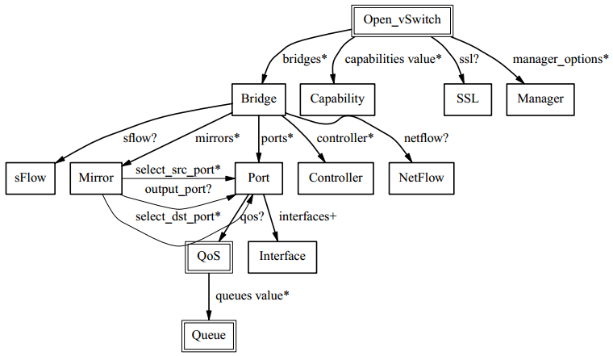
OVSDB Table Relationships
?: zero or one
*: zero or more
+: one or more

Slide 38
OVS Example
# Show the current bridges and the attached ports,interfaces
> ovs-vsctl show
# Show OpenFlow information
> ovs-ofctl show br-int
# print all flow entries
> ovs-ofctl dump-flows br-int
# add flows
> ovs-ofctl add-flow br1 nw_src=192.168.1.2,nw_dst=192.168.2.2, \ idle_timeout=0,icmp,action=mod_nw_src:172.16.206.2, \
mod_nw_dst:172.16.121.2,output:0
> ovs-ofctl add-flow br1 nw_src=192.168.1.2,nw_dst=192.168.2.3, \ idle_timeout=0,icmp,action=mod_nw_src:172.16.206.2, \ mod_nw_dst:172.16.121.3,output:0

Slide 39
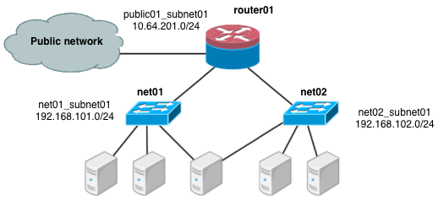
OVS in OpenStack
Scenario: one tenant, two networks, one router

Slide 40
References
Scott Shenker, Software Defined Networking, http://inst.eecs.berkeley.edu/~ee122/
OpenFlow official website at http://www.openflow.org
NOX controller at http://www.noxrepo.org/
J. Pettit, J. Gross, B. Pfaff, M. Casado, S. Crosby, “Virtual Switching in an Era of Advanced Edges,” 2nd Workshop on Data Center – Converged and Virtual Ethernet Switching (DC-CAVES), ITC 22, Sep. 6, 2010.
B. Pfaff, J. Pettit, T. Koponen, K. Amidon, M. Casado, S. Shenker, “Extending Networking into the Virtualization Layer,” HotNets-VIII, Oct. 22-23, 2009.
S. Zhou, “Virtual Networking,” ACM SIGOPS Operating Systems Review, 2010.
N. Mckeown et al., “OpenFlow: Enabling Innovation in Campus Networks,” white papers. The OpenFlow Switch Consortium, March 2008, http://www.openflowswitch.org//documents/openflow-wp-latest.pdf
Y. Luo et al., “Accelerating OpenFlow Switching with Network Processors,” Proc. ACM/IEEE Symp. Architectures for Networking and Communications Systems (ANCS 09), ACM Press, 2009.
J. Naous et al., “Implementing an OpenFlow Switch on the NetFPGA platform,” Proc. ACM/IEEE Symp. Architectures for Networking and Communications Systems (ANCS 08), ACM Press, 2008.
H. Chen et al., “A Survey on the Application of FPGAs for Network Infrastructure Security,” IEEE Communications Surveys & Tutorials, June 2010.
F. Azmandian et al., “Virtual Machine Monitor-Based Lightweight Intrusion Detection,” ACM SIGOPS Operating Systems Review, July 2011.
H. Bos and K. Huang, “A network intrusion detection system on ixp1200 network processors with support for large rule sets,” in Technical Report 2004-02. Leiden University, 2004.

Slide 41
Questions ?

